Slide 1
Boot Strap

Slide 2
Boot strap
What is it?
Why do we use it?

Slide 3
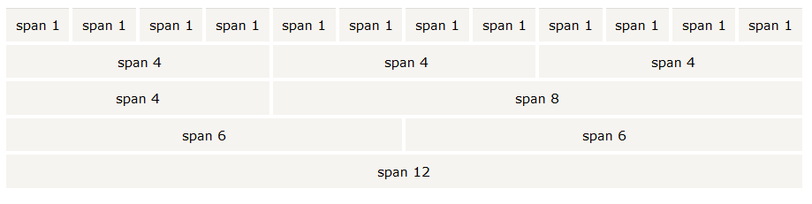
Grids

Slide 4

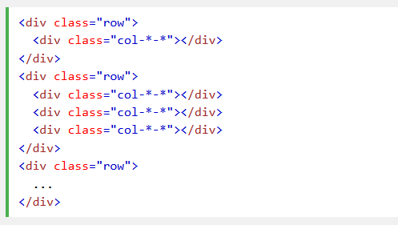
grids
4 classes:
Xs (for phones)
Sm (for tablets)
Md (for desktop)
Lg (Large desktop)

Slide 5
Other features
Typography
Tables
Images
Well
Alerts
Buttons
….

